Slide 1
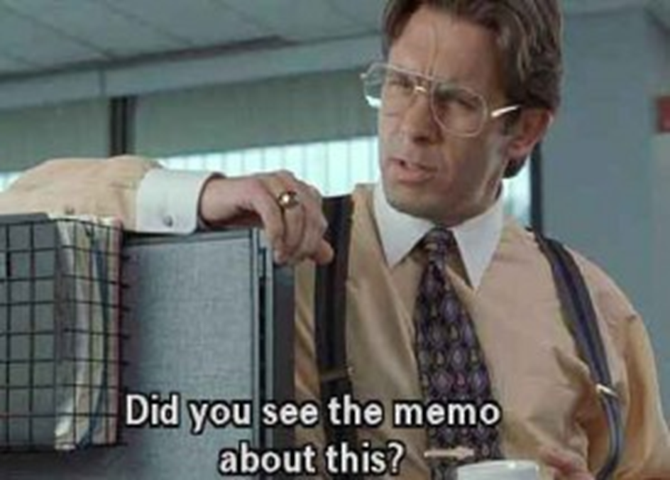
Memo Format

Slide 2
Memos
Memo = short for Memorandum
Internal documents - Business messages sent between people in the same company
Address ONE specific subject
Purpose: To inform, update, or persuade
  Inform the reader about new information like policy changes, price increases, or by persuading the reader to take an action, such as attend a meeting, or change a current production procedure

Slide 3
Memos
Usually written very formally
Submitted as hard copy or in email format (as message itself, or as an attachment)
Usually 1-2 pages
Ends with action information

Slide 4
Memo Structure
Typically follow a simple structure
  As simple as possible to draw the reader’s eye to the key information that they need to know
Use headings to break longer memos into sections
Explanation of memo formatting, in the format of a memo:
  Memo Format

Slide 5
Formatting of memo
Formatted differently from letters – do not need a greeting
Include Date/To/From/Subject fields
Do not indent paragraphs
Subject lines required
Headings recommended, especially for long memos

Slide 6
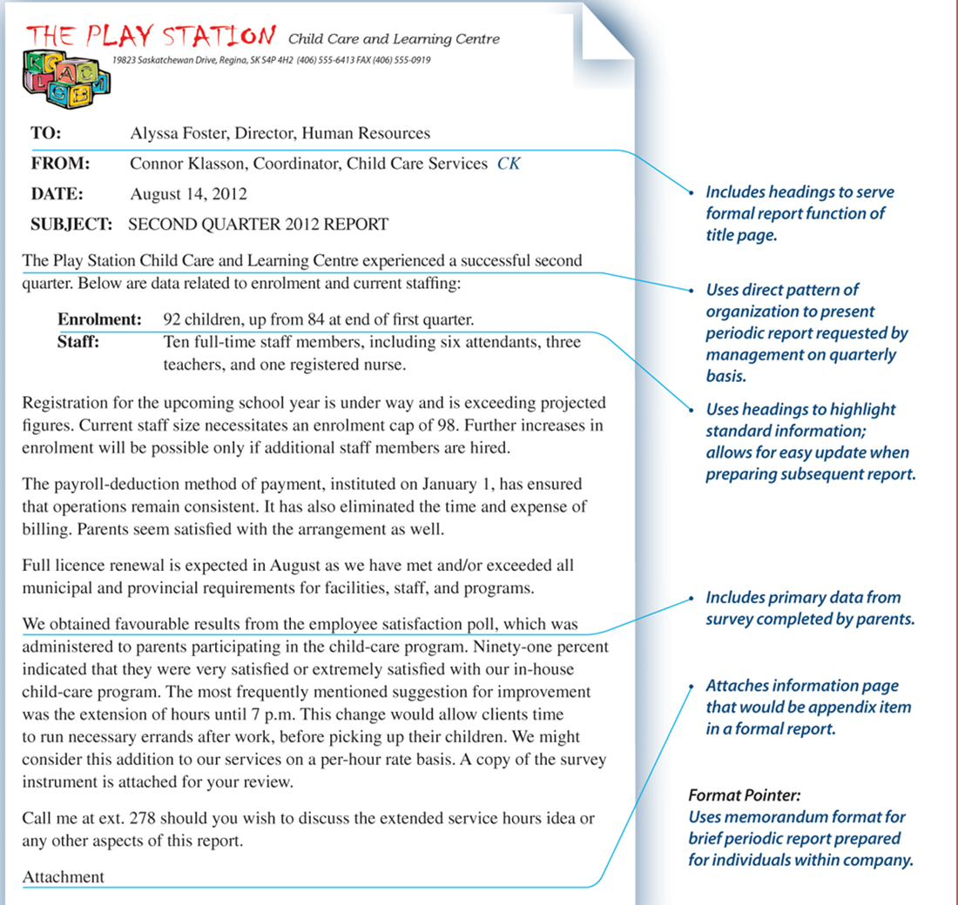

Slide 7
4 parts of a memo
Subject line
Opening
Body
Closing

Slide 8
Subject Line
Informative subject line is mandatory because it summarizes the central idea
Do not use 1-word subject like Problem, Important, or Help
Effective subject line explains the purpose of the message and how it relates to the reader.
  3 Employees needed to represent company at Electronics Trade Show Oct. 16
Written in abbreviated style (no a, an, the). Need not be complete sentence, no period required

Slide 9
Opening
Take direct approach to message – reveal main idea immediately with a purpose statement
State your purpose in first sentence, even though it has been summarized in subject line
  Busy readers want to know immediately why they are reading the message
  Ex: The purpose of this memo is to inform all employees of an upcoming change to payroll timesheet submission.

Slide 10
Opening
Example Indirect Opening:
Subject: Did you enjoy Orientation?
Opening: First-year students, did you have a good experience at SLC Orientation? Here at St. Lawrence College we want to make sure we are providing a memorable introductory week for our students. Administration would like your feedback about the week.

Slide 11
Opening
Example Direct Opening:
Subject: Student Feedback Requested for Orientation Committee Review
Opening: Please provide SLC Administration with your feedback on Orientation Week 2018 by completing this short survey.
Note: when writing a memo, do not type “Opening”

Slide 12
Body
Provides more information about the reason for writing
Explains subject logically and clearly
  1st paragraph contains most important information
  2nd paragraph contains supporting information
  3rd paragraph…
Organize info using headings, numbered lists, tables, graphic highlighting

Slide 13
Closing
Generally end memo with:
  A) A summary of the message and recommendation
  B)Action information, dates or deadlines
  C) A closing thought or courteous close
For long or complex memos, a summary of main points is necessary
  Summarize your main points in a paragraph. 1-2 sentences per criteria.
  Worded in different way than body to avoid repetition
  After summary, make recommendation
Readers will be looking for deadlines or action information
  Ex: Please submit your response by November 21 so we can have your feedback before our next meeting

Slide 14
Closing
Ending with a goodwill statement or courteous closing thought avoids feeling of abruptness or coldness
  I’m glad to answer your questions
  This sounds like a useful project
  I sincerely appreciate your help
  Please let me know if you have any questions or suggestions
  Thank you for your patience and understanding in this matter

